Slide 1



Mass Loss and Pre-supernova Properties of Massive Stars
Camille Cioffi, Dr. Carl Fields
University of Arizona
Arizona Space Grant Consortium
AZSGC Statewide Student Research Symposium
April 17-18, 2026
Arizona State University

Slide 2
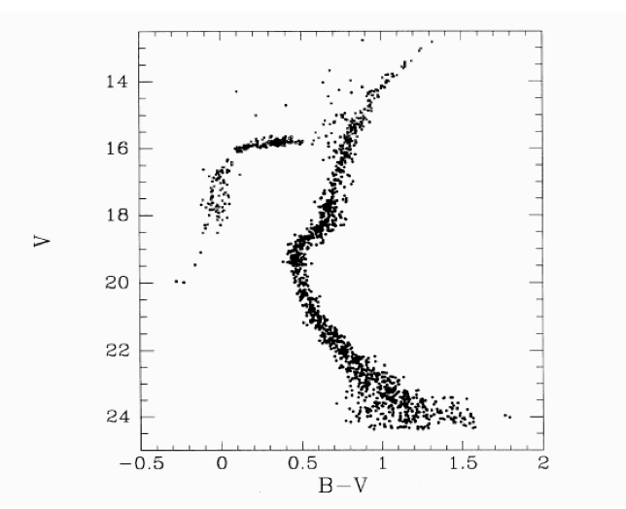
Stellar Evolution Modelling
Stars lives are governed by complex, interacting processes
Observations give us data points
Theory gives us physical motivations for these data points
Models bridge the gap
Luminosity
Main Sequence
Temperature
AZSGC Statewide Student Research Symposium
Camille Cioffi
Paxton et al. 2011
Notes:
Make it clear that the top is observation and the bottom is theory
Snapshot in time vs evolutionary tracks

Slide 3
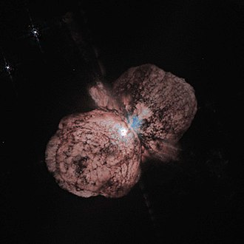
Accurate Modeling is Essential!
Models are used for many purposes by astronomers
Treatments of physics in models affects the eventual explosion and compact remnant properties
  Affects production of elements!
AZSGC Statewide Student Research Symposium
Camille Cioffi
NASA/HST: Eta Carinae
Massive star in Milky Way
Notes:
Connect the pretty picture to the actual work
Bolding/word color

Slide 4
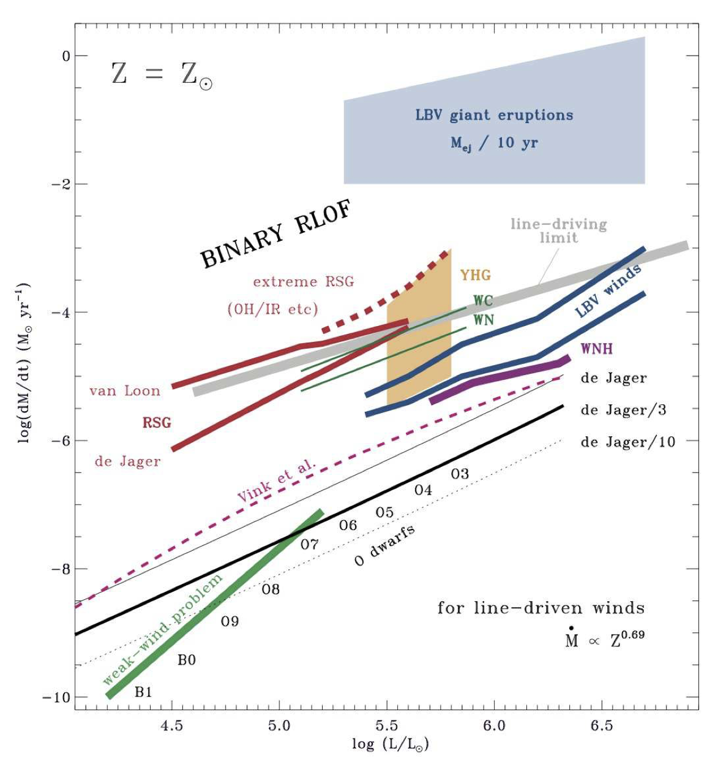

Mass Loss: My Project
Smith (2014)
Mass loss in massive stars in stellar evolution models
  Modules for Experiments in Stellar Astrophysics (MESA)
Current prescriptions are from decades-old empirically motivated studies
Implementing findings from new studies into massive star mass loss routines
Mass Loss Rate
Luminosity
AZSGC Statewide Student Research Symposium
Camille Cioffi
Notes:
Talk a little about hot (more understand) vs cool (less understood) winds and the diversity of winds using this plot
No theoretical prescription (combine physics and empirical data)
Put some numbers for perspective

Slide 5
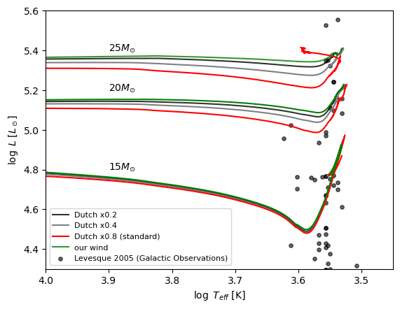
Findings
Our updated rates are much lower than the standard prescription post-main sequence
  Factor of 3-10
  Larger difference for higher masses
Produce higher mass supernova progenitors, which impacts the nature of the star’s death
AZSGC Statewide Student Research Symposium
Camille Cioffi
Notes:
Ideas for the plot: 15, 20, 25 with the new rate, ducth 0.8, some other dutch scaling factor

Slide 6
Future Work
Incorporate these updated mass loss rates into large grid of 1D massive star models
Provide an openly-accessible resource for supernova simulations and other stellar science
Eventually implement our rates into models that incorporate 3D physics and binaries
AZSGC Statewide Student Research Symposium
Camille Cioffi
Notes:
Mention different metallicities, rotation, magnetism, connecting to observation (ex. advance LIGO)

Slide 7
I would like to thank the Arizona Space Grant Consortium for providing me the opportunity to work on this project, as well as my mentor Dr. Carl Fields and our group at Steward Observatory for supporting me.

Slide 8
Thank You
Camille Cioffi
cioffi@arizona.edu

